Slide 1
eSafety
Lesson 2 – Cyber Bullying Part 1
http://www.yahmad.co.uk/

Slide 2





Starter
What is Cyber bullying?
Can you identify the different methods of cyber bullying.
http://www.yahmad.co.uk/

Slide 3
Lesson Overview
Objectives
To understand what cyber bullying and its effect on society and individuals.
To understand what could be done to prevent cyber bullying.
Outcomes |  | Time
Task 1 | Q&A Answer questions related to the cyber bullying video.
Task 2 | Discuss in MS Teams what could be done to prevent cyber bullying.
Task 3 | Create a simple poster creating awareness of cyber bullying and its effects.
Extension: | Letter and Video Task.
http://www.yahmad.co.uk/

Slide 4
Task 1 – Cyber Bullying Q&A
Watch the Video Cyber Bullying Video
What is cyber bullying and how has it effected the person in the video?
How would you feel if you were in the same position as this boy?
What advice would you pass on to someone who was suffering from cyber bullying?
http://www.yahmad.co.uk/

Slide 5
Task 2: How to Prevent
Discuss in the MS Teams what could be done to prevent cyber bullying.
How would you prevent cyber bullying?
http://www.yahmad.co.uk/

Slide 6
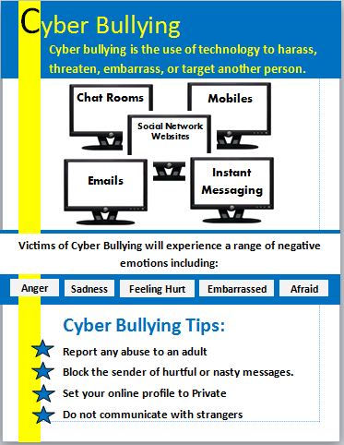
Task 3: Create a Poster
Create a simple poster creating awareness of cyber bullying and its effects.
Can be done on Paper or Computer. Refer to the example
Aim: To create awareness and to provide guidance against cyber bullying.
http://www.yahmad.co.uk/

Slide 7
Plenary – Refer to the Lesson Objectives
Objectives
To understand what cyber bullying and its effect on society.
To understand what could be done to prevent cyber bullying.
Plenary Task (Q&A)
Each member of the class has to either give positive advice to stay safe online or provide a potential danger in the MS Team Post.
http://www.yahmad.co.uk/

Slide 8

Extension Work – Upload Work
Letter Task
Create a letter which could be sent to parents to informing them about the dangers of cyber bullying and threats posed towards their children.
Video Clip
Create a short video on your phone to create awareness and to provide guidance against cyber bullying.
http://www.yahmad.co.uk/

